Slide 1
Online Safety
Nov 2022

Slide 2
Online Safety
This is a safeguarding information assembly and will cover the following areas:
A reminder of the four ‘Cs’ of online safety
Specific risks

Slide 3
The 4 C’s of online safety
CONDUCT
You can put yourself at risk by the way you behave online. You may think you are being anonymous, but you can very easily leave a digital footprint. It is very important that you are careful about the information that you are sharing. You need to manage your Privacy Settings.
CONTENT
You can be at risk from accessing and viewing inappropriate content via social media, apps, online games and websites. E.g. the death of Molly Russell in 2017 and the subsequent inquest.

Slide 4
The 4 C’s of online safety
CONTACT
You can put yourself at risk of being contacted by strangers, and people who may wish to cause you harm. Having appropriate privacy settings and being cautious about information sharing is very important.
COMMERCIALISM
You can be at risk from advertisements and in-app purchasing in online games and applications. Being cautious with your privacy settings, closing pop-ups etc, are very important.

Slide 5
Specific risks…
Inappropriate use of social media and apps.
Cyberbullying – including prejudicial language
Sexting, inappropriate images, nudes and semi-nudes.

Slide 6
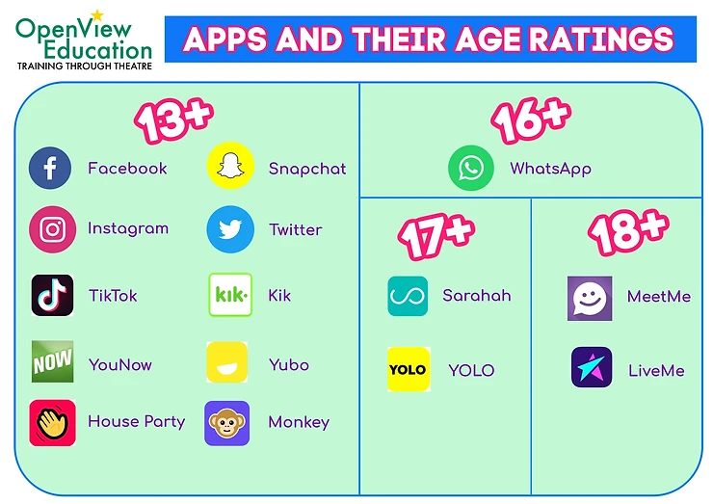

Slide 7
A word about social media apps
Some of you are using WhatsApp:
The minimum age is 16
Risks of bullying particularly in group chats
Risk of strangers accessing you via group chats
Sharing live location – could be seen by strangers
Spam or hoax messages
Access to inappropriate content.
Important to control privacy settings, leave group chats you are not comfortable with and report anyone of concern.

Slide 8
A word about social media apps
Many of you use Snap Chat:
The minimum age is 13
Risks of inappropriate content and bullying.
Risks of being ‘groomed’ into sharing images and information with strangers who have the intent to cause harm.
You should:
Only use it with genuine friends
Ask yourself before you share anything – ‘would I be happy for other people to see this?’
Report any issues – difficult to act without evidence. The safest way is to take a screenshot with another device.

Slide 9
A word about social media apps
Many of you use Tik Tok:
The minimum age is 13
Risks of inappropriate content and bullying.
Your profile information is still public even with a private setting – need to not put too much info on it.
We know that:
It can sometimes be used to make bullying and hurtful comments about individuals or groups
Important that you block and report.

Slide 10
Examples of cyberbullying
Spreading malicious and abusive rumours and gossiping
Emailing or texting you with threatening or intimidating remarks
Mobbing (a group or gang that target you)
Harassing you repeatedly
Intimidation and blackmail
Stalking you on-line and continually harassing you
Posting embarrassing or humiliating images or videos without your consent
Posting your private details on-line without consent
Grooming (enticing or goading you on-line to self-harm or commit a crime)
Setting up a false profile, Identity fraud or identity theft
Using gaming sites to attack or bully you
Theft, Fraud or deception over the internet

Slide 11
When should you take action?
If you see something inappropriate
If someone spreads rumours about you
If you are being threatened
If you are being blackmailed
Grooming
If someone posts inappropriate pictures of you.
It is important to report to us. We will work with other agencies e.g., the police, Children’s Services and there can be serious consequences through the school for anyone involved in this behaviour.

Slide 12
Sharing images…
We know that people send nude or semi-nude images for a variety of reasons:
As part of a relationship
Messing around with friends
Intimacy as part of a relationship
Flirting with someone they are interested in
Being pressured to do so.

Slide 13
It is important to know the law
It is an offence to possess, distribute, show and make indecent images of anyone under the age of 18.
It is an offence to view indecent images of anyone under the age of 18.
These laws were created to prevent adults from harming children, not to criminalise people under the age of 18.
However, anyone under the age of 18 who does these things is breaking the law.
No-one wants to criminalise children, and if the police become involved then this is primarily for safeguarding.
Important to ensure there is no coercion, intent to cause harm, bullying, harassment, grooming, blackmail or intimidation.

Slide 14
What should you do…
If you have:
Had an indecent image shared
Received an indecent image from someone else
Shared an indecent image of someone else.
Or if you are concerned that someone else has done the above.
You should report it to us so that we can help and delete anything you have.
You should never put pressure on anyone else to send you nudes or semi-nudes.

Slide 15
Finally
Situations can cause stress, upset and anxiety. You might even be frightened to talk to us because you are worried about getting into trouble.
Remember that we are here to help keep everyone safe.
Remember that we should be respectful to each other.
Reporting things is not being a snitch. It’s about making sure that no-one comes to harm, or continues with behaviours that are not acceptable. This could have more serious consequences in the future.
staysafe@testbourne.school

Slide 16
THANK YOU
A short survey will be sent out to you via email as for previous assemblies.

